Slide 1
Reference (3) Speech Materials
Jeff (CHI-HSUAN HO)
The subsequent slides only showcase a few parts of the work materials and results.

Slide 2
The following slides only demonstrate few parts of materials and results.
Jeff (CHI-HSUAN HO)

Slide 3
Multi-Omics Factor Analysis (MOFA) A Framework for Unsupervised Integration of Multi-omics Data Sets
Jeff (CHI-HSUAN HO)

Slide 4
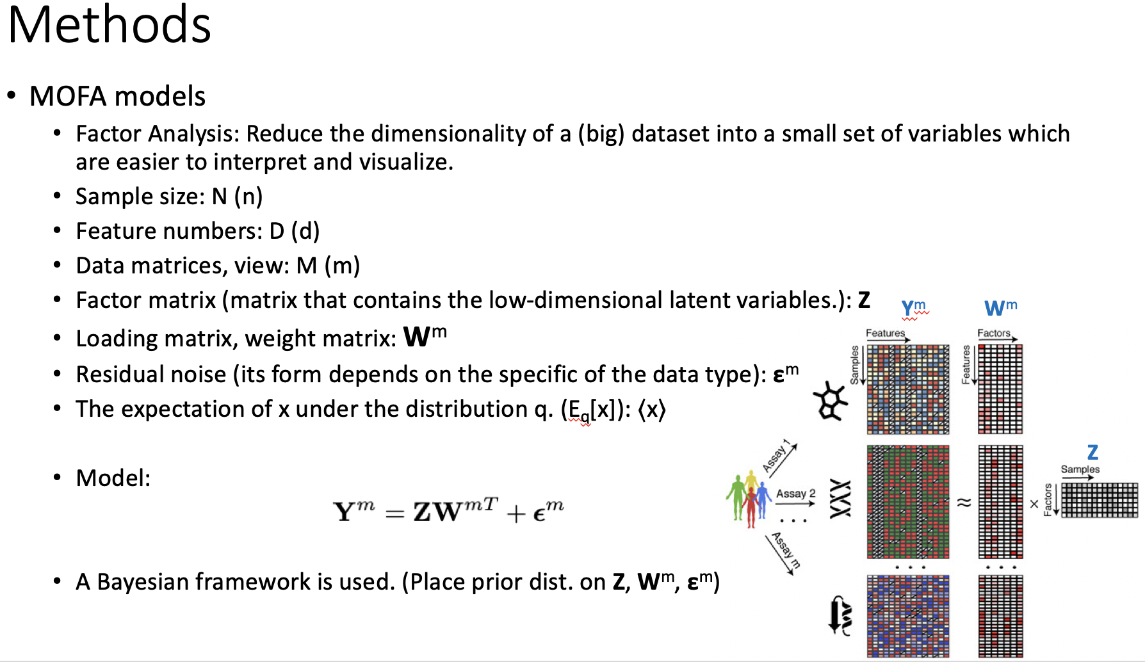
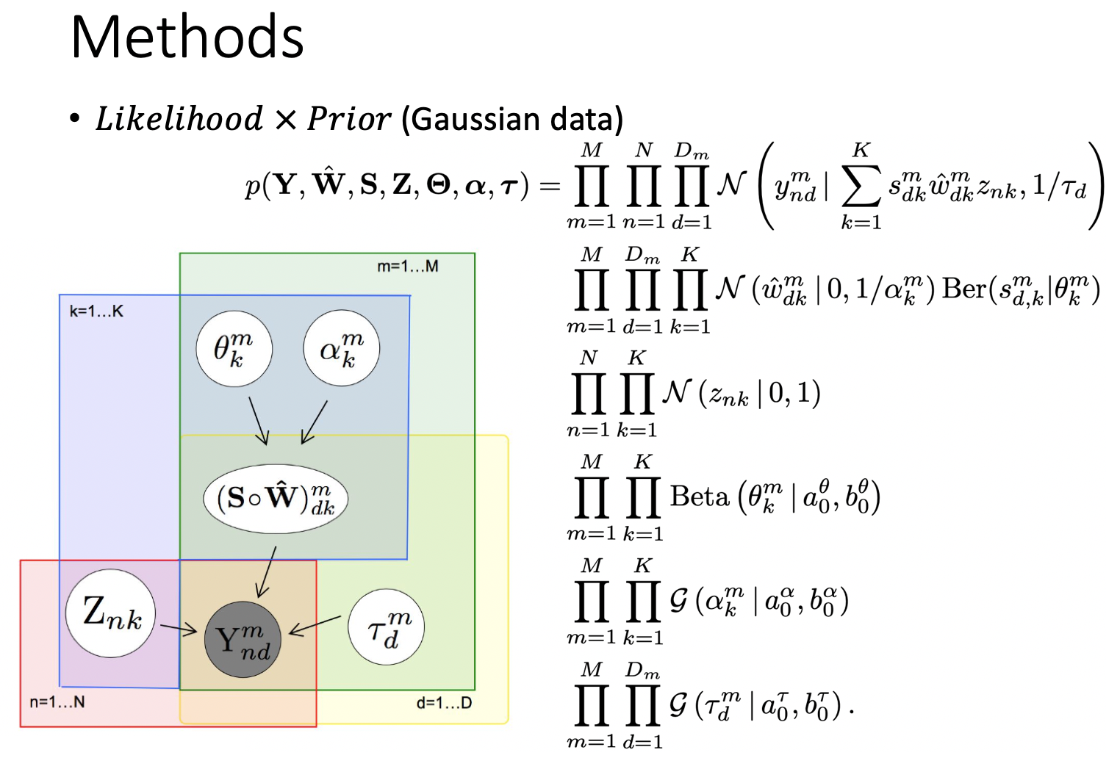
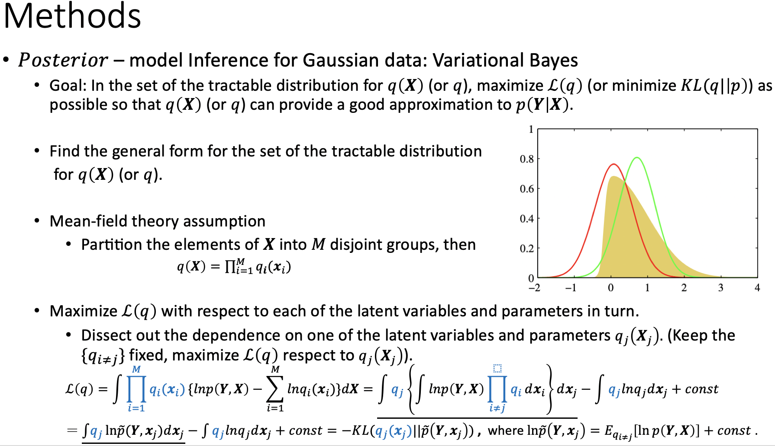
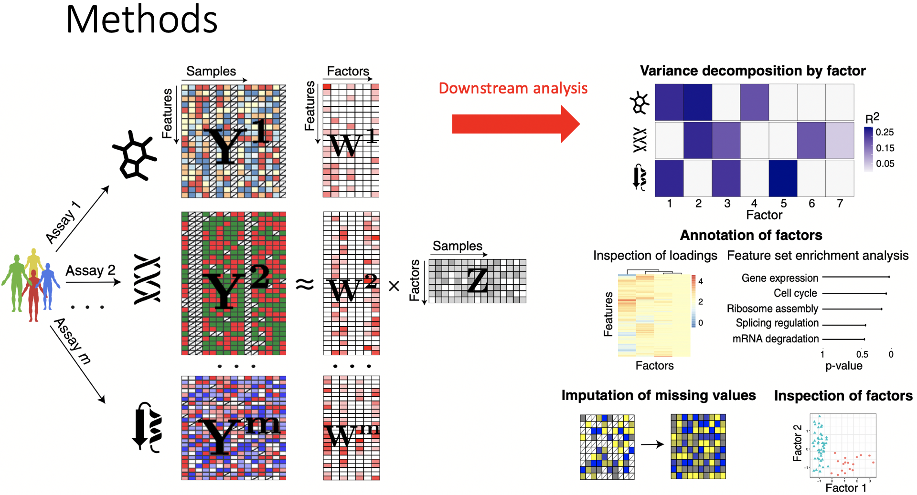
Materials
https://github.com/jeff665547/SkillShare-MOFA/raw/master/MOFA.pdf

Slide 5
Dimension Reduction Techniques From t-SNE to UMAP
Jeff (CHI-HSUAN HO)

Slide 6
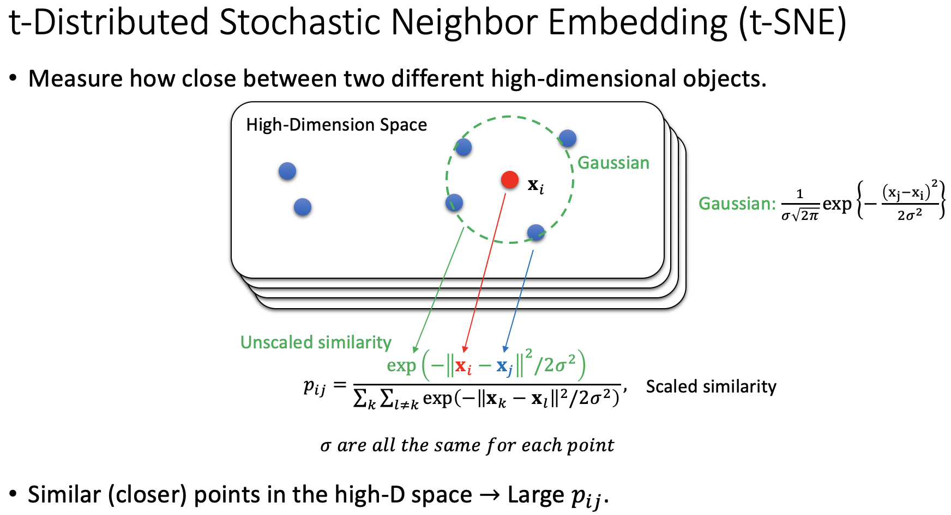
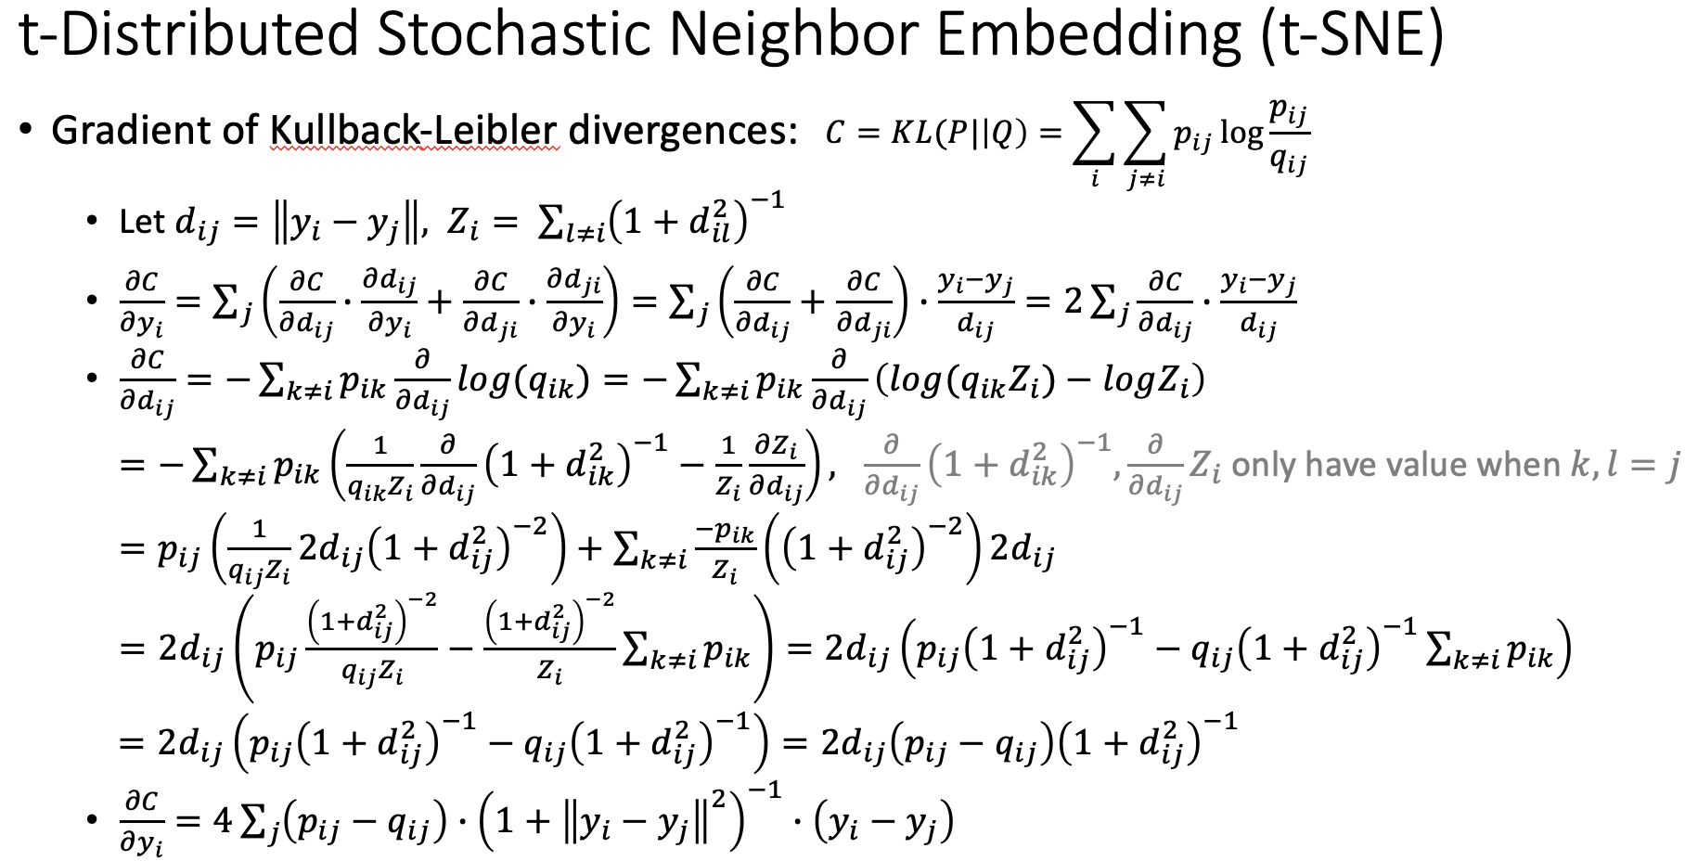
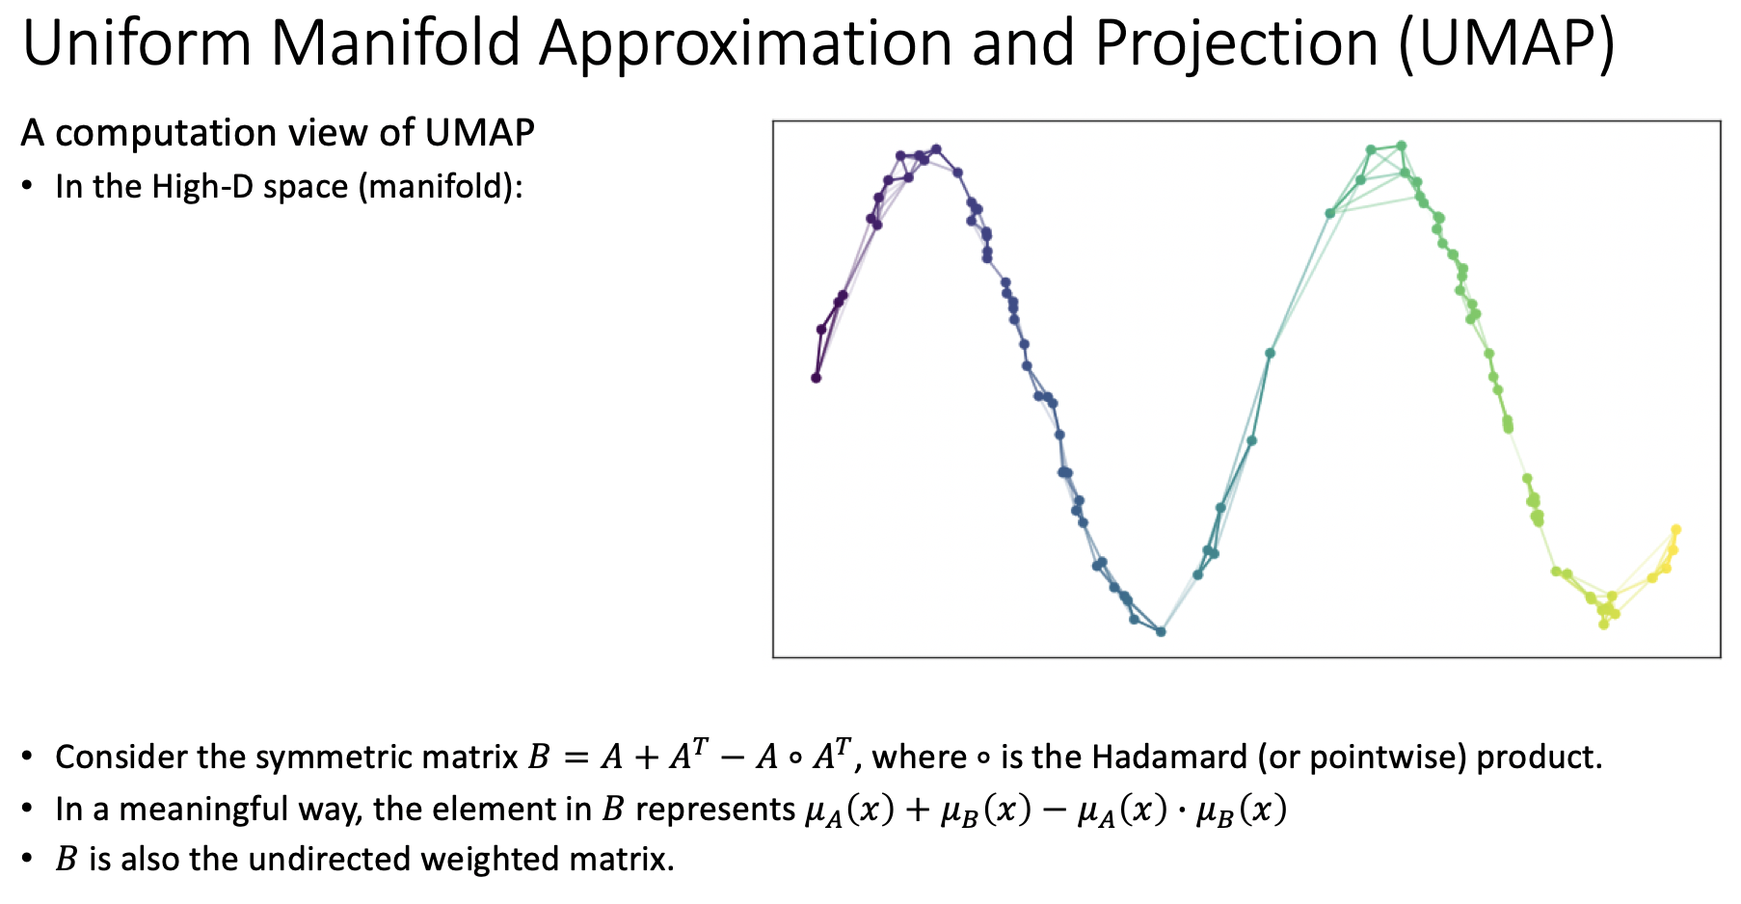
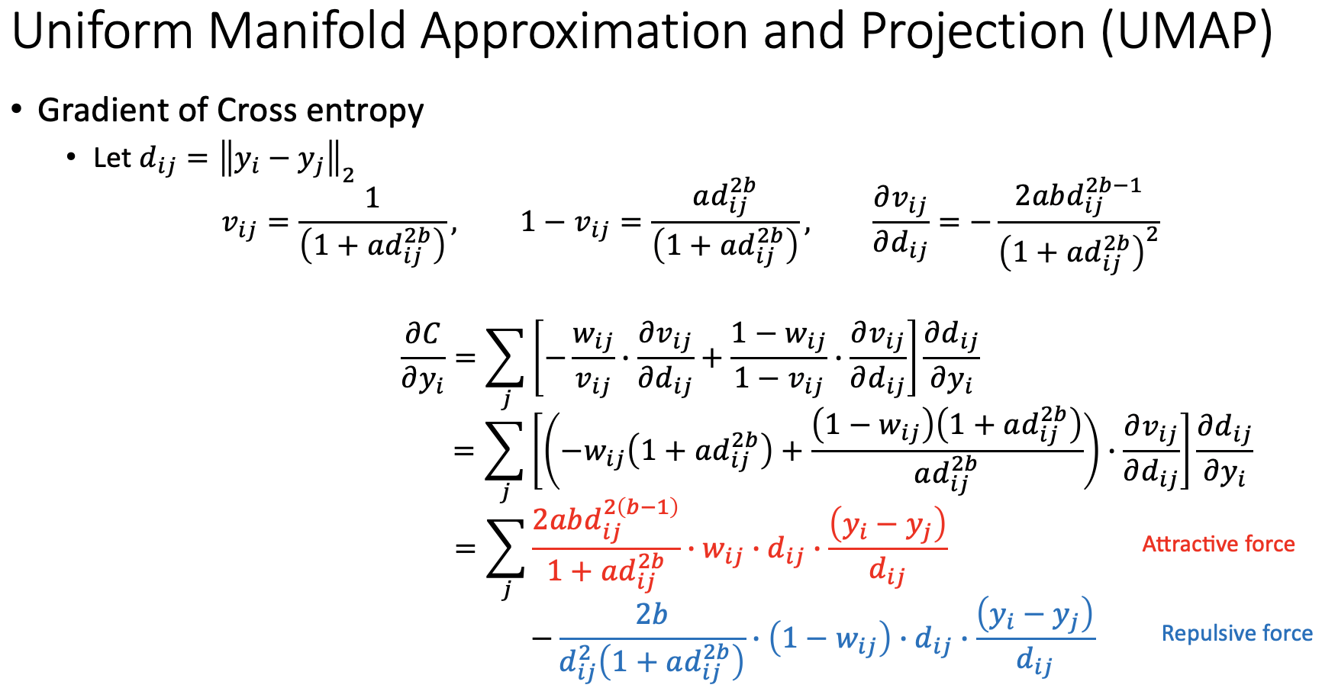
Materials
https://github.com/jeff665547/SkillShare-UMAP-and-t-SNE/raw/master/From%20t-SNE%20to%20UMAP.pdf

Slide 7
Interpretable Dimensionality Reduction of Single Cell Transcriptome Data with Deep Generative Models (SCVIS)
Jeff (CHI-HSUAN HO)

Slide 8
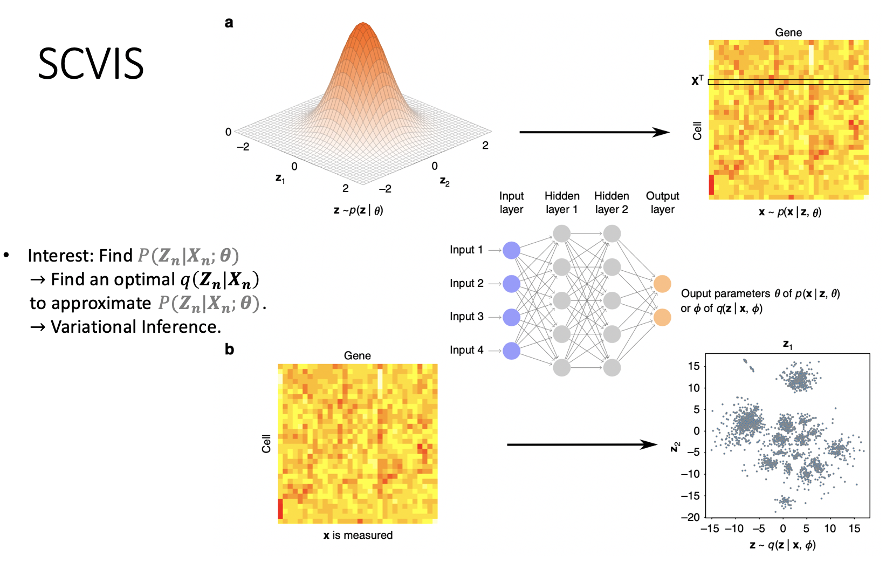
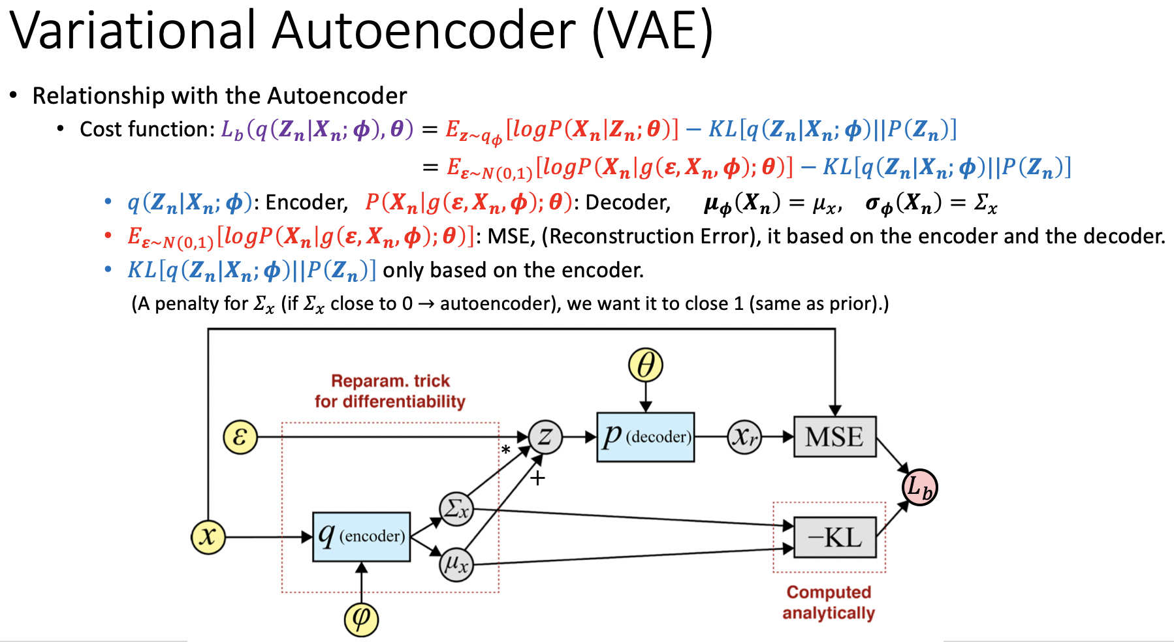
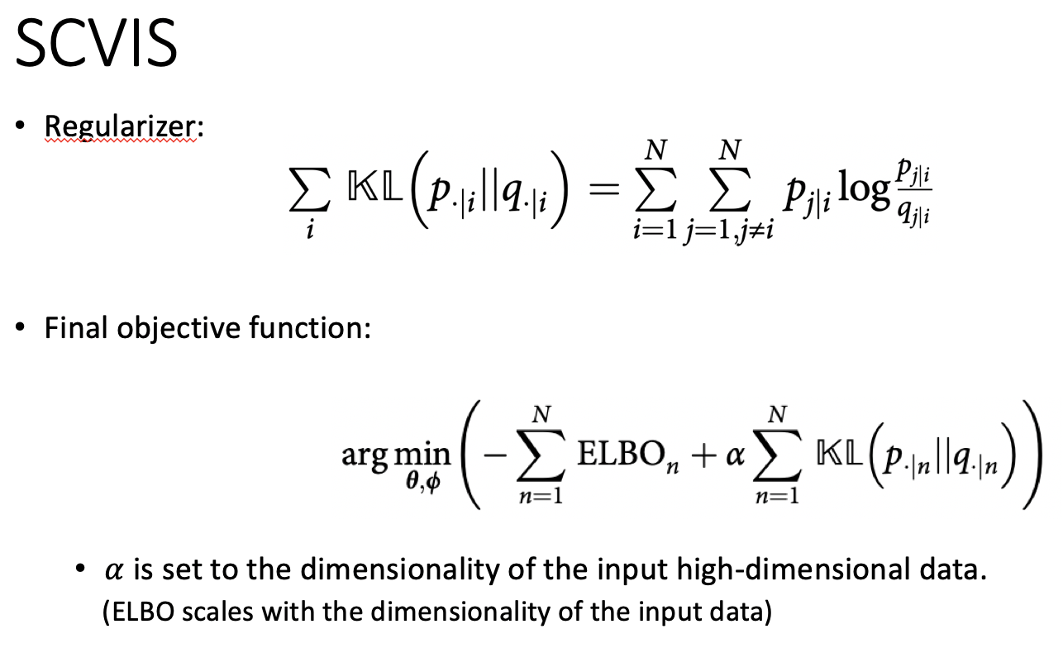
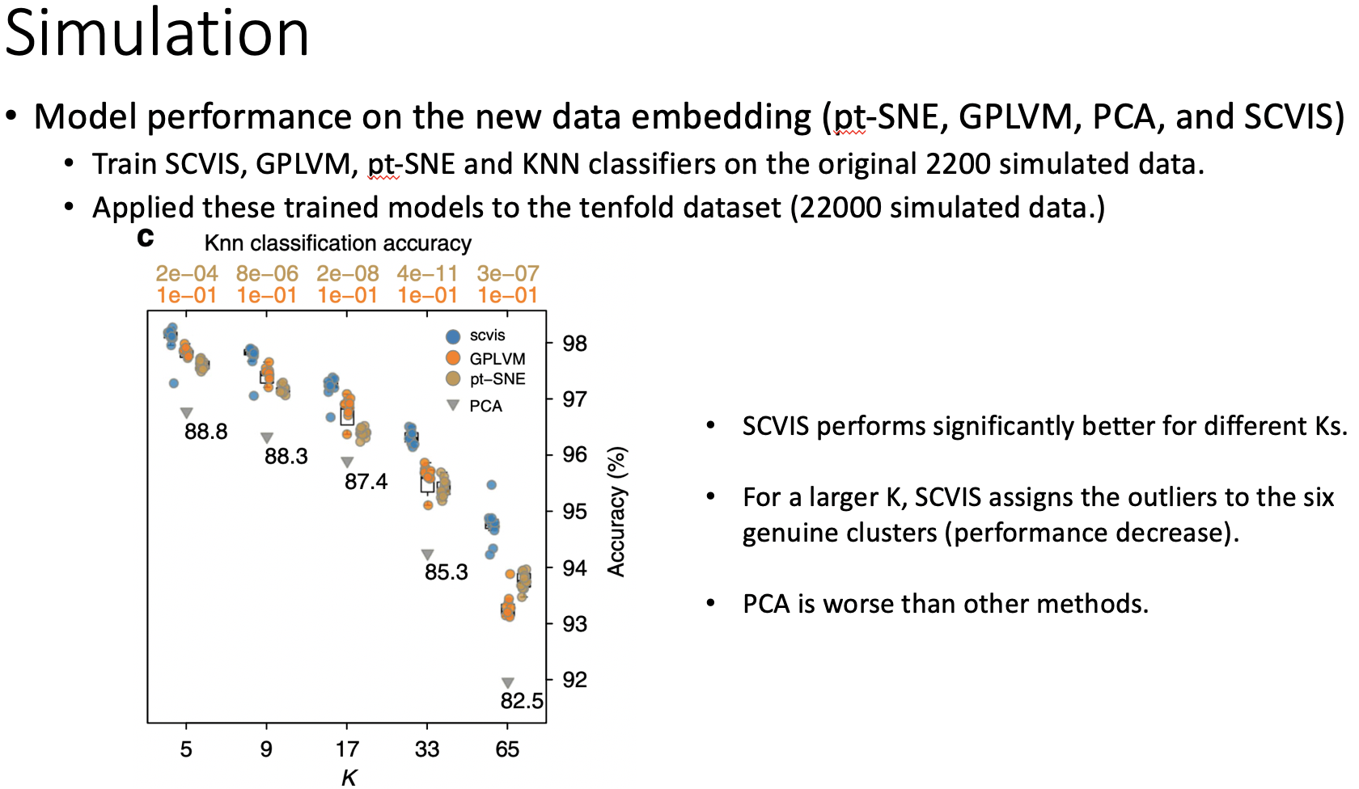
Materials
https://github.com/jeff665547/SkillShare-SCVIS/raw/master/SCVIS%20A%20VAE-based%20approach.pdf

